Slide 1

MA7FZTY
Done By: Ganna Ayman, Rola Wafi, Kareem Ehab, Youssif Assem, Mohamed Moataz
Supervised by: Dr. Hossam Rahman, Mahmoud Haider

Slide 2
Agenda
Introduction.
Problem Statement.
Experiments.
Results.

Slide 3
Introduction
Ma7fzty is an application that will help people to save their money change.
It allows individuals to transfer remaining money electronically from one account to another.
People lose money daily because they don’t find money change easily.
1
2
3

Slide 4
Problem Statement
People lose money daily because shops don’t usually have change and it ends up on people losing small change everywhere.
Though this may be considered the "old-fashioned way" when it comes to transferring money, using cash can be extremely practical in some circumstances.
Sometimes its hard getting the remaining money in cash which is really annoying.
A lot of people don’t like to carry a lot of money with them because they are exposed to stolen.

Slide 5
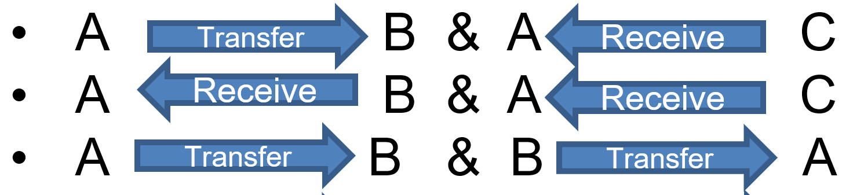
Experiment Cases
User A transfers money to user B, and at the same time user C transfers money to user A .
User
A B & A C
A B & A C
A B & B A
A B & C B
A B & C D
A B & C D
Transfer
Receive
Receive
Receive
Receive
Transfer
Transfer
Transfer
Transfer
Transfer
Transfer
Receive
Receive

Slide 6
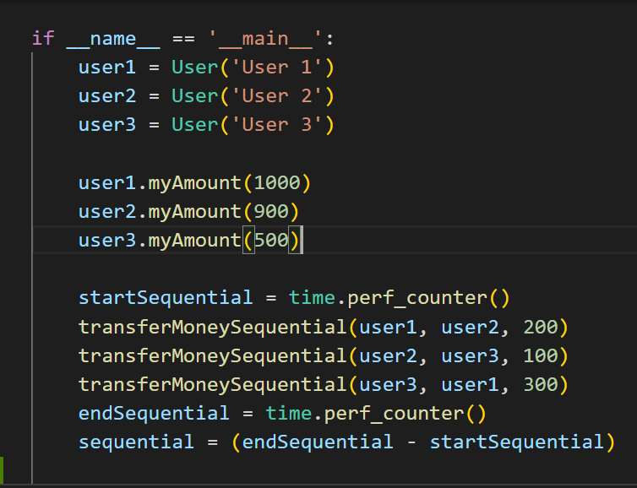
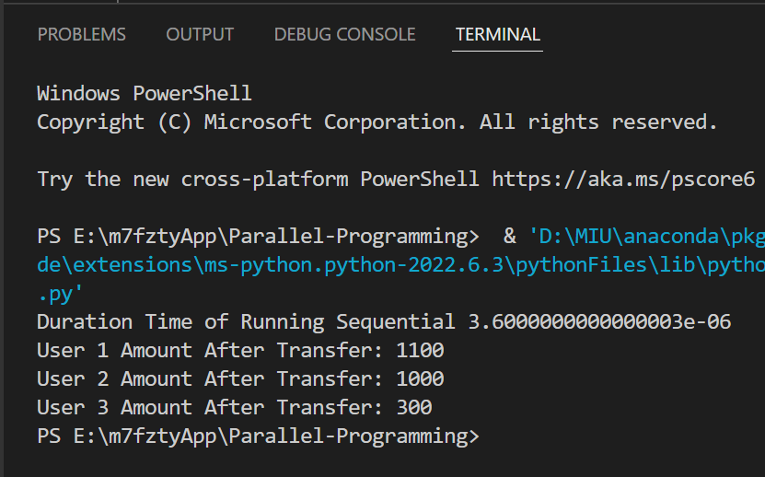
Sequential implementation:
Experiment applied: Results
Conclusion:
The expected results matched the actual results but the output took a long time.

Slide 7
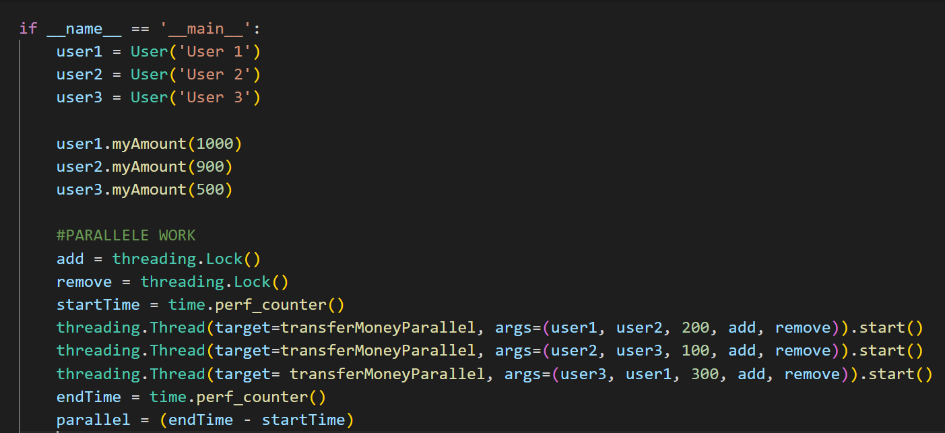
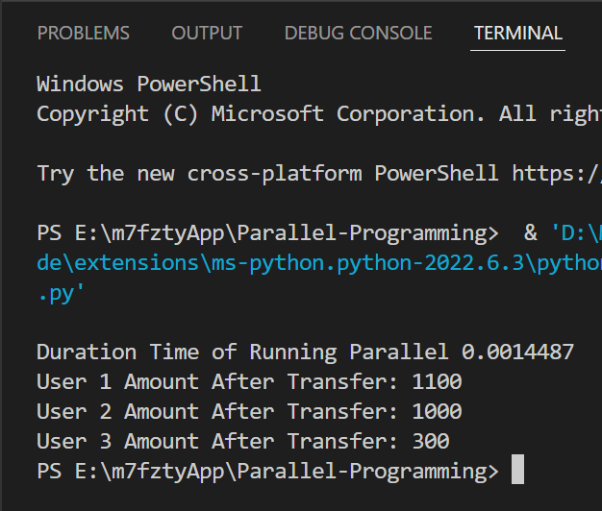
Parallel implementation(using threading and locks:
Experiment applied: Results
Conclusion:
The expected results matched the actual results and the output took a shorter time.

Slide 8
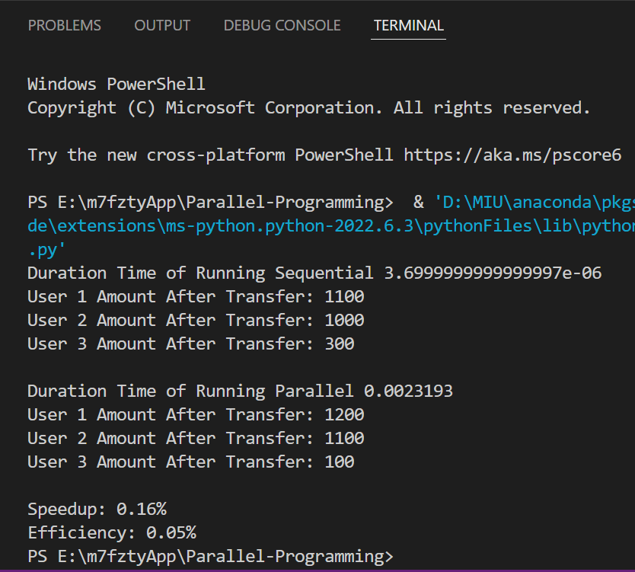
Evaluating parallel Vs. Sequential performance:
Knowing that the time could differ with each run, we can say that the parallel performance was much better than the sequential one with average speed up = 0.16%

Slide 9


Any Question
Any Question

